Slide 1
FETAL ALCOHOL SPECTRUM DISORDERS (FASDs)
NEWAYGO COUNTY MENTAL HEALTH
Notes:
Welcome to Newaygo County Mental Health's presentation on Fetal Alcohol Spectrum Disorders

Slide 2
The material provided in this presentation is for informational purposes only.
The content of the presentation is not intended to provide medical advice or diagnoses.
Notes:
The information provided is for educational purposes and not intended to provide a medical diagnoses. There are resources provided at the end of the presentation where additional information can be found. The presentation will provide an overview, including definitions, cause, symptoms, and other general information, in order to increase awareness of these preventable disorders.

Slide 3
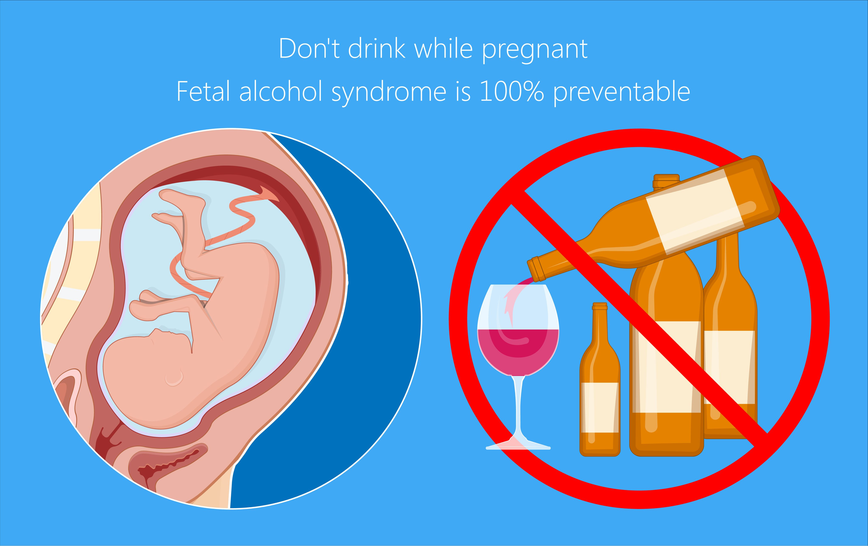
WHAT IS IT?
CDC definition – “A group of conditions that occur in a person who was exposed to alcohol before birth.”
Leading known cause of PREVENTABLE intellectual disabilities.
Notes:
Let's start with a brief definition. The CDC defines it as A group of conditions that occur in a person who was exposed to alcohol before birth. These disorders are 100% preventable. It is important that a person who is pregnant abstains from drinking any alcohol during the pregnancy. Alcohol includes beer, wine, and hard liquers. There is no safe amount of alcohol that can be consumed during pregnancy. It is also recommended that a person who is trying o become pregnant also refrain form consuming alcohol to remove the risk of exposure to the growing baby.

Slide 4
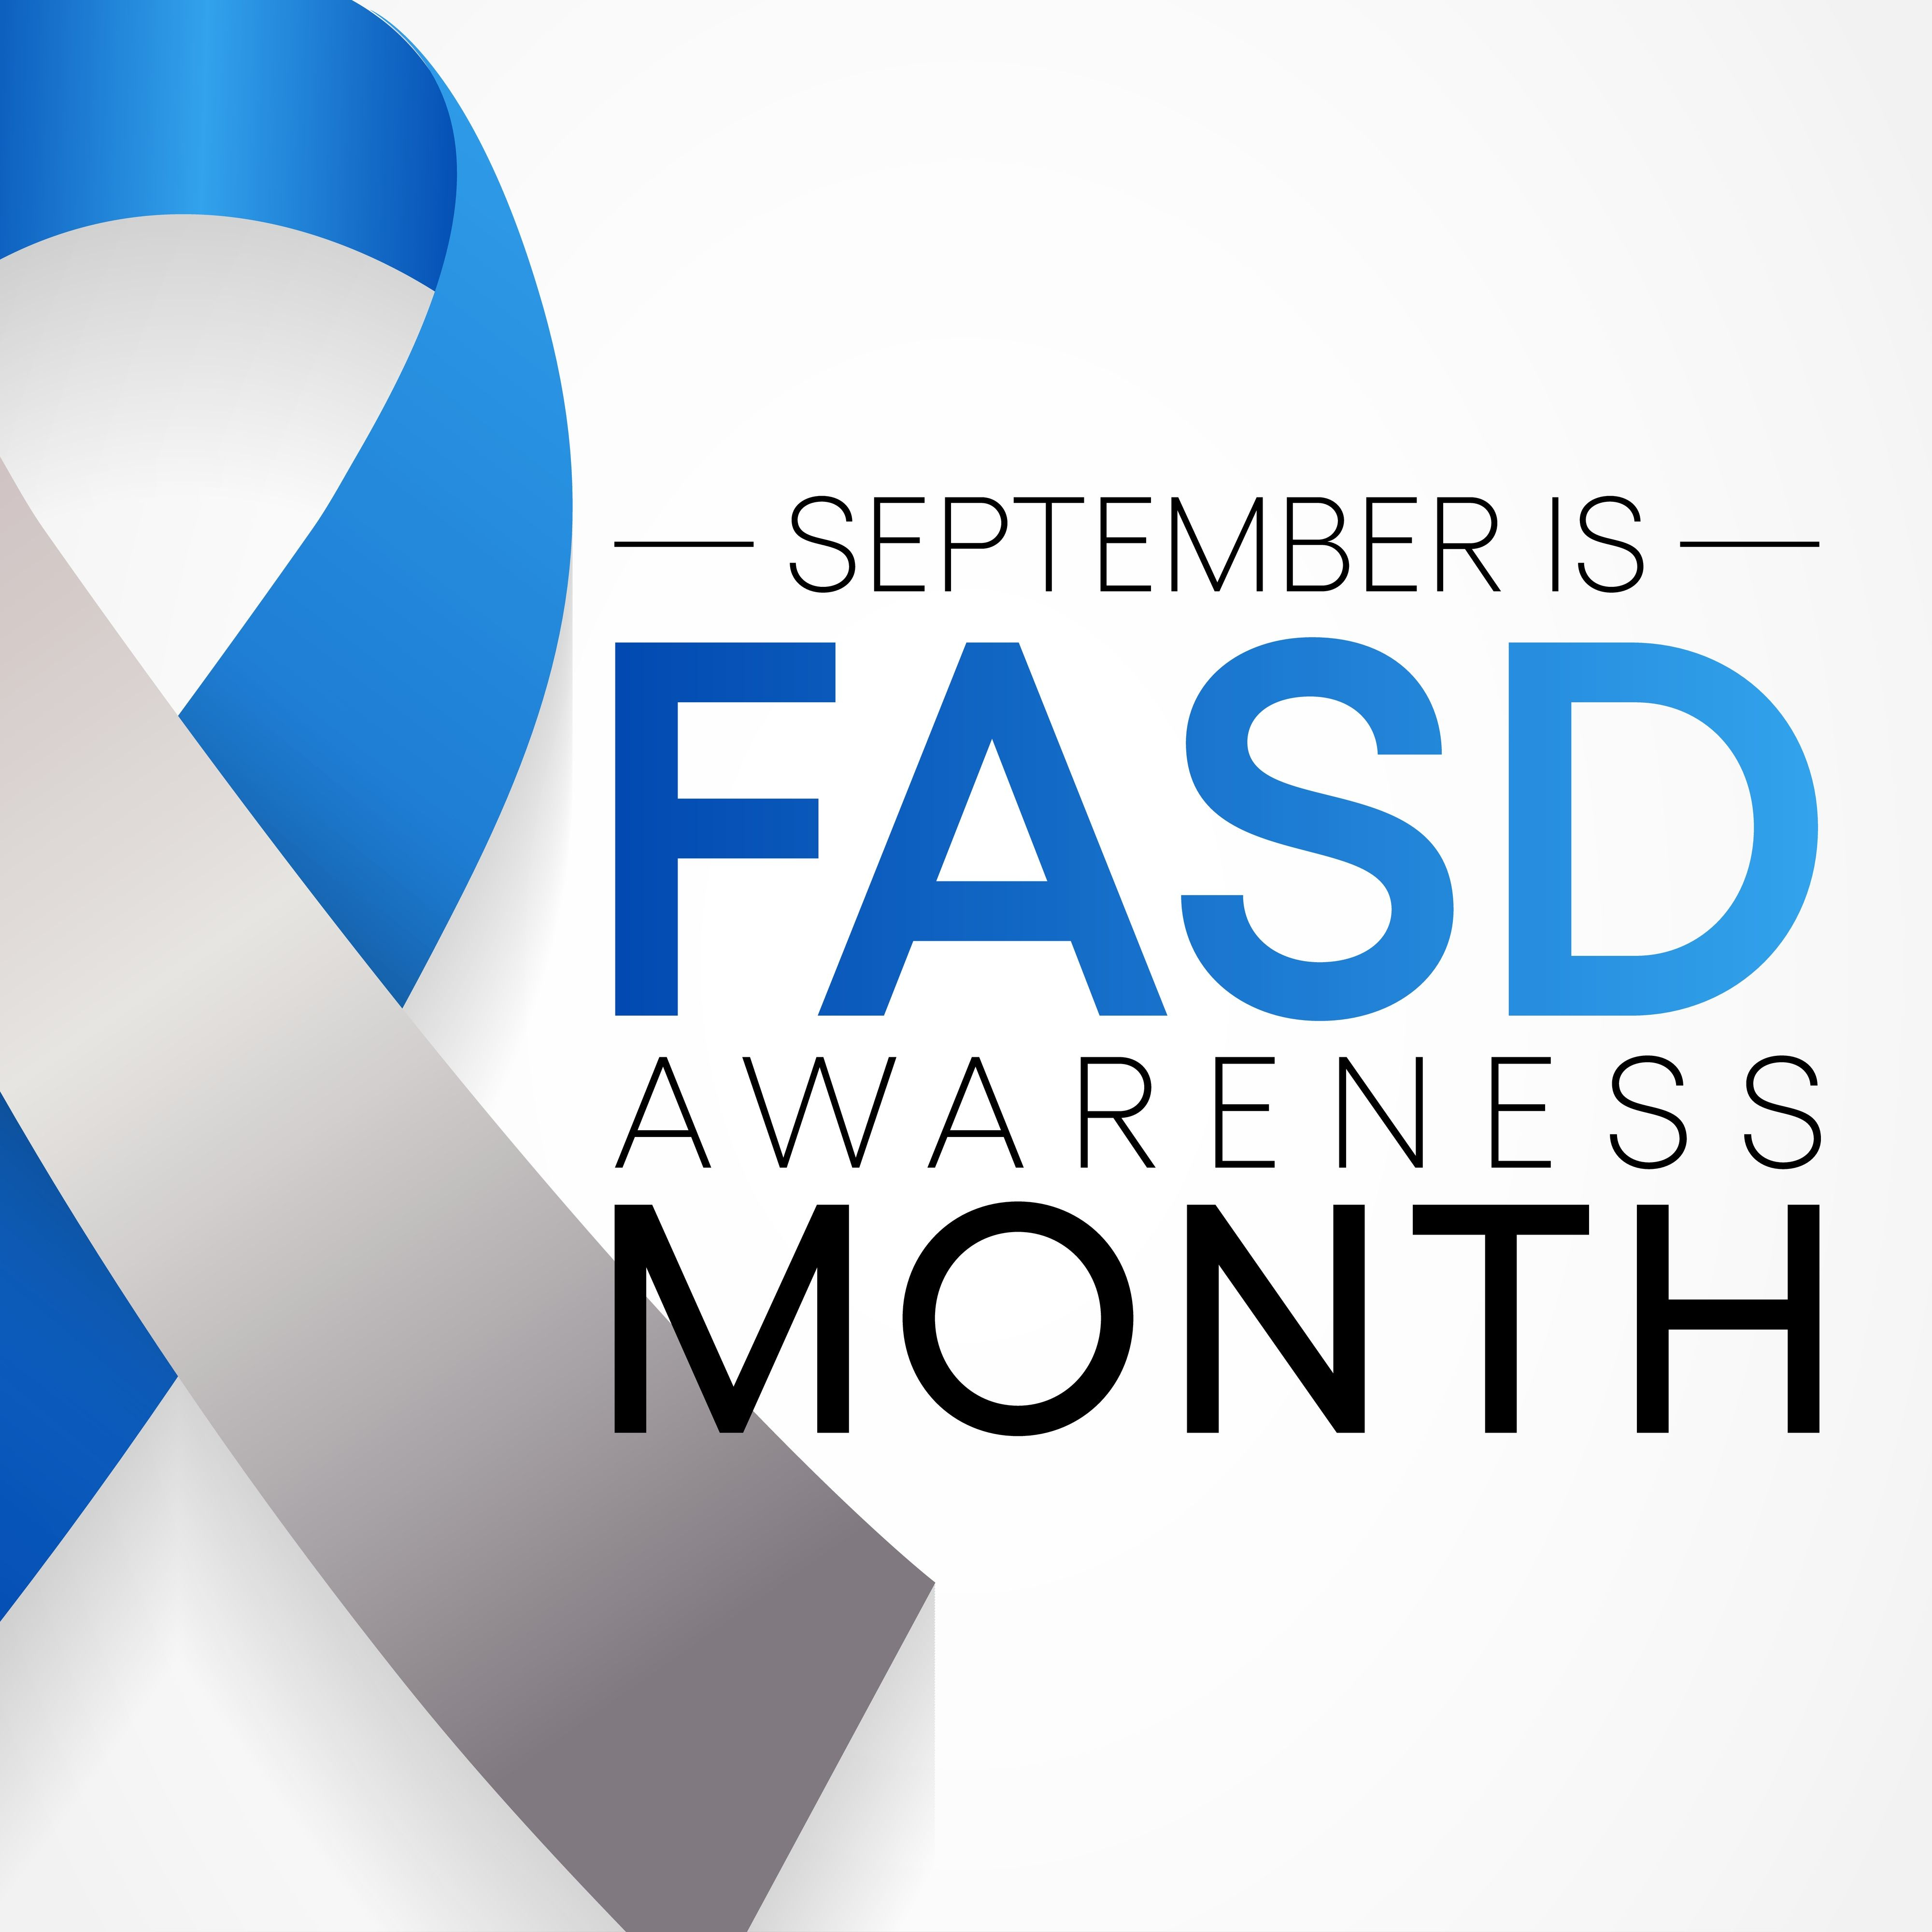
“Of all the substances of abuse, including heroin, cocaine, and marijuana, alcohol produces by far the most serious neurobehavioral effects in the fetus.”
Institute of Medicine Report to Congress (1996)
Notes:
The Institute of Medicine reported to congress in 1996 that Of all the substances of abuse, including heroin, cocaine, and marijuana, alcohol produces by far the most serious neurobehavioral effects in the fetus. This remains true to this day.

Slide 5
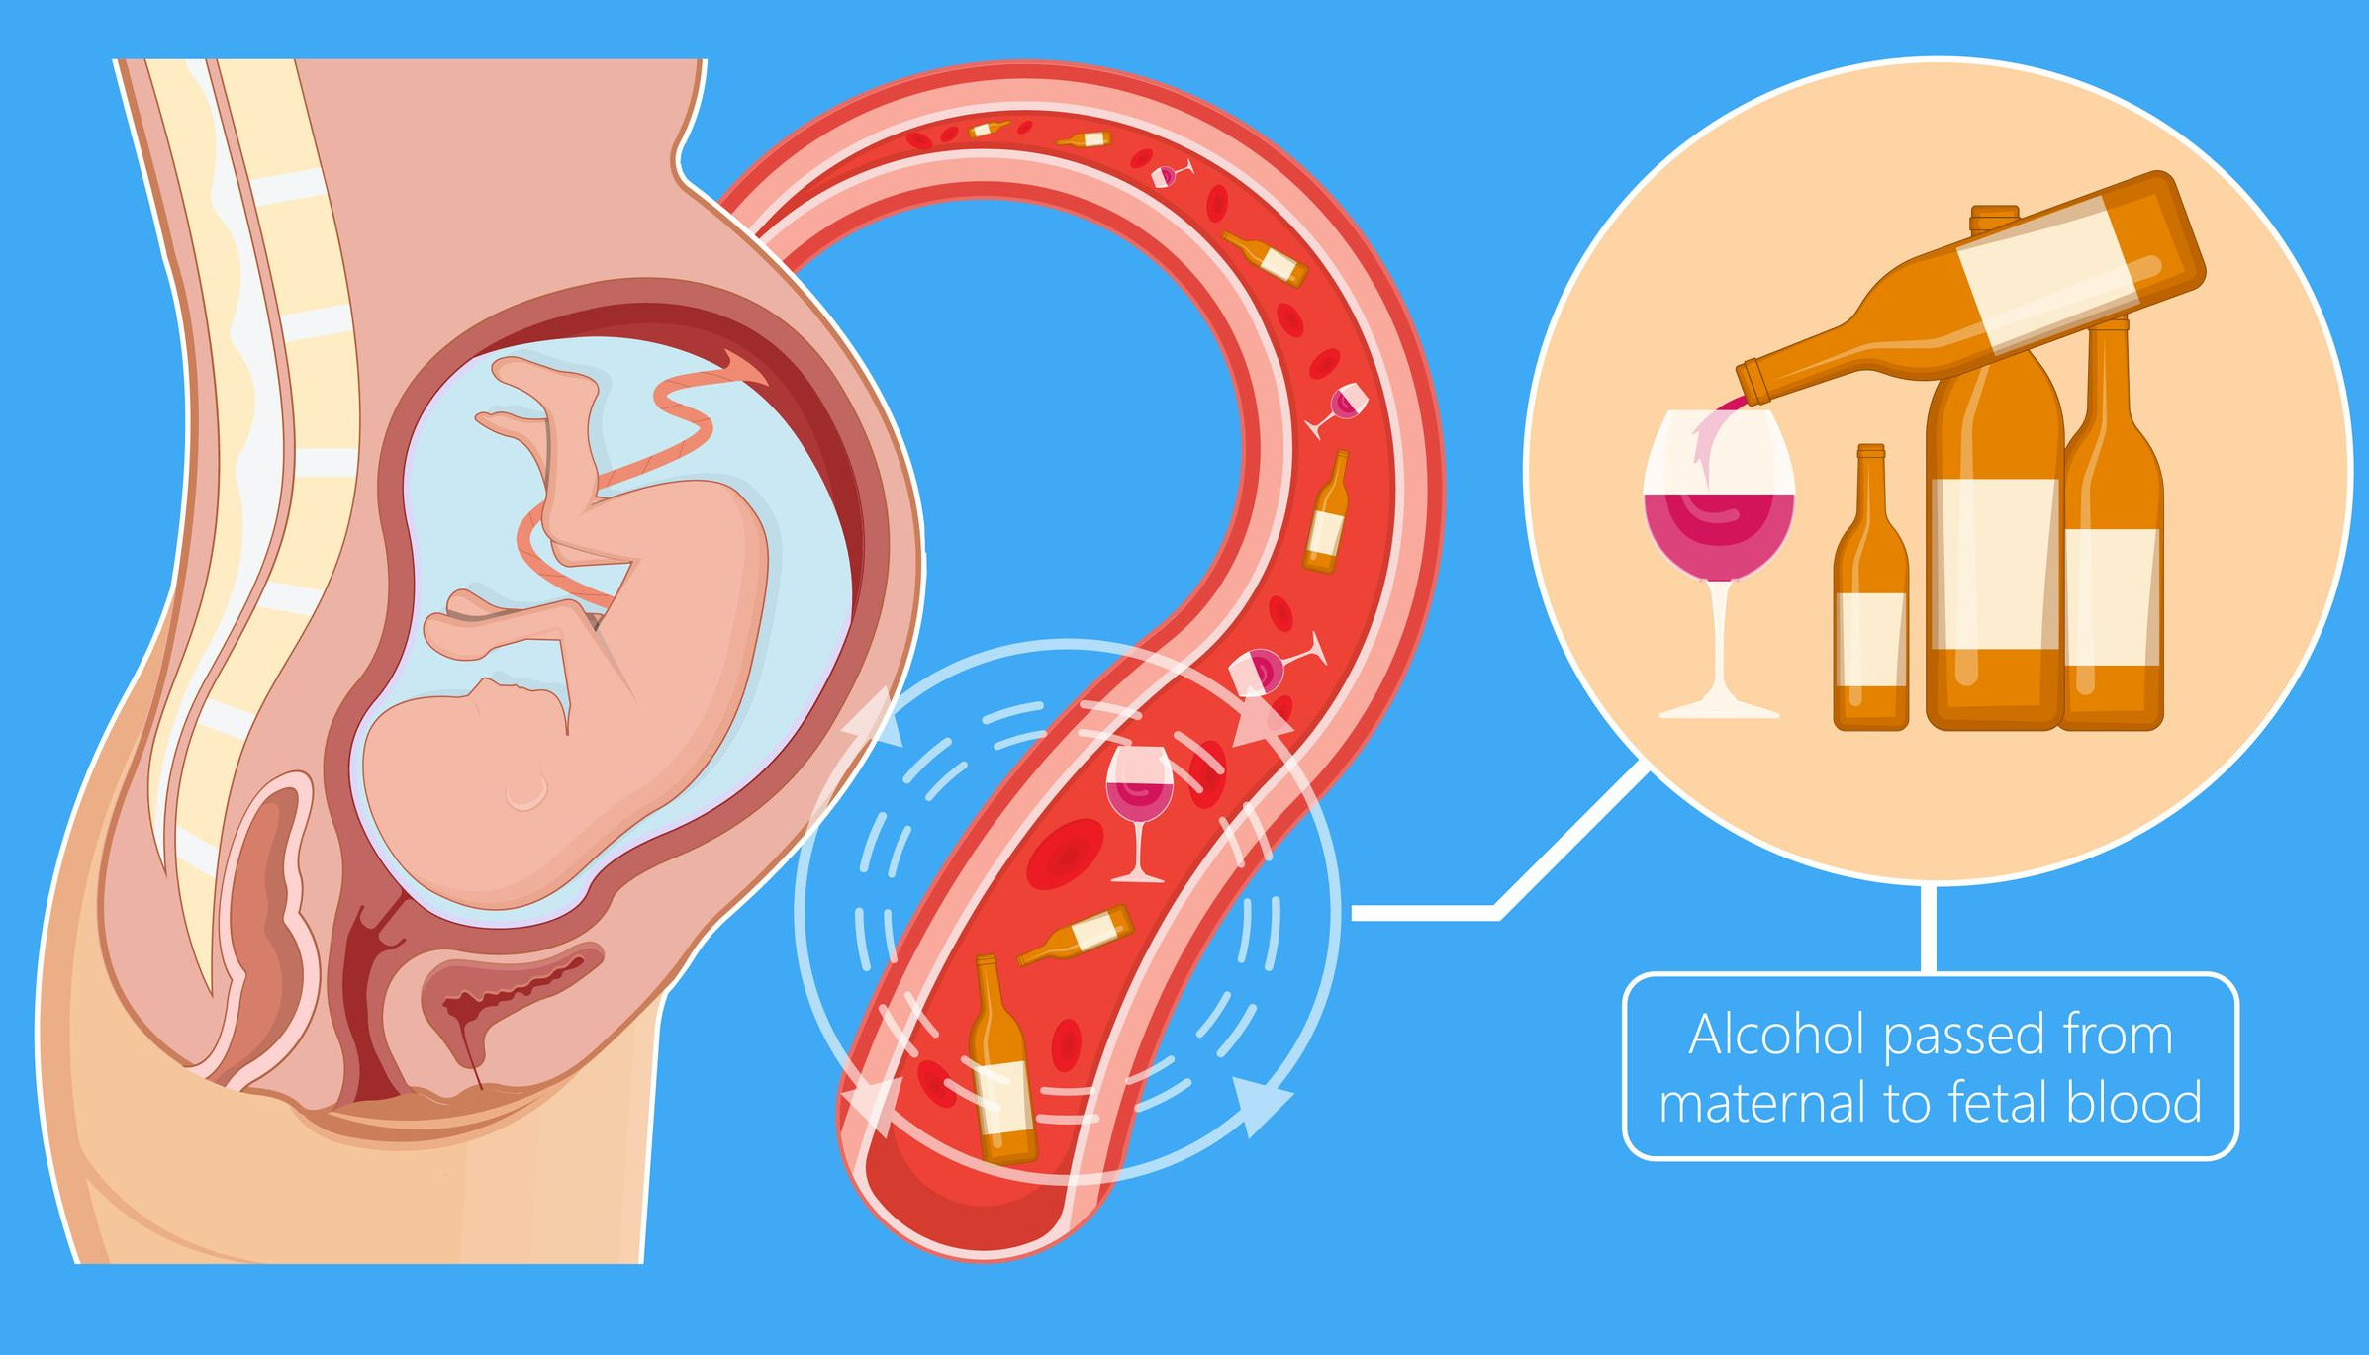
Notes:
FASDs can occur at any time during pregnancy when the baby is exposed to alcohol before birth. The alcohol is passed on to the baby through the blood in the umbilical cord. There are many people who may drink and are unaware they are pregnant. It is important that, as soon as the pregnancy is known, that consumption of alcohol stops, and prenatal care is started. It is important to share with the doctor that there was alcohol consumed before the pregnancy was discovered.

Slide 6
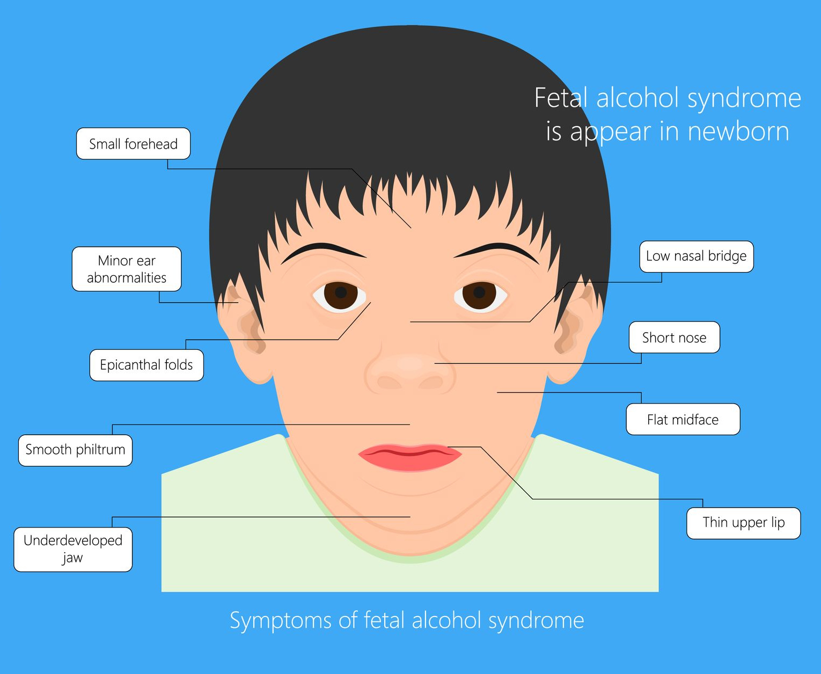
Features
Small eyelid openings
Short, upturned nose
Long upper lip (from nose to mouth) with a thin red border and lacking a central groove
Reduced size of the head
Notes:
People who are born with an FASD may have recognizable features, such as such as a smooth ridge between the nose and upper lip, smaller head size, and short upturned nose. Their eyes may appear to be smaller or a thin upper lip.

Slide 7
FASD Diagnoses
There are several disorders within the spectrum and diagnoses is linked to the symptoms.
Can have both physical and behavioral problems.
Notes:
Not all people who are diagnosed with an FASD will have the same symptoms. And the symptoms may be physical or behavioral. Some may only have one or two symptoms and others may have a long list of both behavioral and physical issues. It is important to talk with your doctor if you consumed alcohol during the pregnancy to monitor for these symptoms. As there are several disorders within the spectrum, we will look at the primary symptoms for each of these.

Slide 8
Alcohol-Related Birth Defects (ARBD)
Potential physical problems with:
Heart
Kidneys
Bone
Hearing
Vision
Can affect several systems in the body.
Notes:
People with Alcohol-Related Birth Defects (ARBD) may have one or more physical birth defects, affecting the heart, kidneys, bones, hearing , and vision

Slide 9
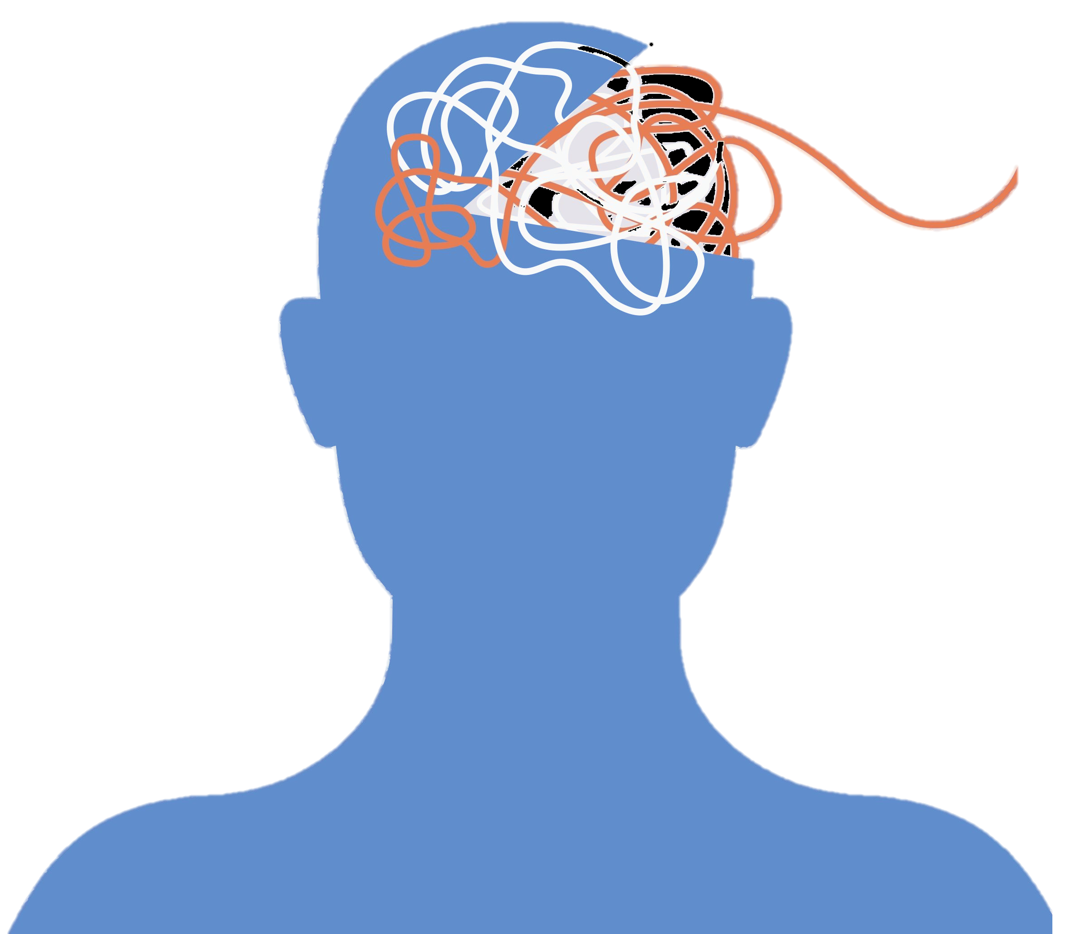
Alcohol-Related Neurodevelopmental Disorder (ARND)
Intellectual Disabilities
Learning Disabilities
Behavioral Issues
Poor Judgement
Poor Impulse Control
Poor Recall
Notes:
Alcohol-Related Neurodevelopmental Disorder (ARND) can affect cognitive functioning, leading to intellectual disabilities, problems with learning and recall. They may act on impulse without understanding the consequences. They could develop significant behavioral issues as well.

Slide 10
Neurobehavioral Disorder Associated with Prenatal Alcohol Exposure (ND-PAE)
Three main areas:
Thinking and Memory
Behavioral (Mood/ADHD)
Basic Living Skills
CDC explains that the mother would have to consume more than 13 alcoholic drinks in one month, or more than 2 drinks in one sitting, for the child to have this diagnoses.
Notes:
Neurobehavioral Disorder Associated with Prenatal Alcohol Exposure (ND-PAE) requires a specific set of criteria. The individual would have reported drinking 2 or more drinks in one sitting or 13 or more drinks in one 30 day period of the pregnancy. There are three main areas that are affected – thinking and memory, mood and attention, and delays in learning basic living skills

Slide 11
Fetal Alcohol Syndrome (FAS)
Central Nervous System problems
Classic Facial Features
Low Birth Weight and Length
Vision and Hearing Problems
Communication Issues
Behavioral Issues
Most involved of the FASDs
Notes:
Fetal Alcohol Syndrome represents the most complex of the disorders. Those who are diagnosed with FAS can have a low birth weight and length, They will demonstrate the recognizable facial features, and may have increased problems with behavioral issues. They may struggle with getting along with others throughout their life.

Slide 12
THERE IS NO CURE
Notes:
It is important to remember that FASDs are lifelong, there is no cure. Prevention is they only way to prevent FASDs. If a baby is diagnosed with an FASD, there are some options for treating symptoms, but again, there is no cure.

Slide 13
TREATMENT
Early intervention to improve development
Early Diagnoses
Decrease stress in home environment
Special Education
Social Services
Training and Education for Parents
Medications for Medical Issues
Notes:
If a person suspects that they are pregnant, and have been drinking, the first thing to they should do is stop all intake of alcohol. Reach out to a doctor to start prenatal care and provide the doctor with the information regarding the alcohol consumption. As mentioned before, If a child is born with an FASD there are some options for the treatment of symptoms. Environment plays a role in the early development of the child. Contacting social services to get linked with support groups and community resources is important for getting the training and education needed to raise a child with an FASD. There are some medications that can be used to help with the medical issues and some for behavioral if needed. Treatment is individual as no two persons carry the same symptoms.

Slide 14
RESOURCES FOR FAMILIES
Information on the FAS:
Mayoclinic.org
Kidshealth.org
CDC.gov
Support for families:
National Organization of Fetal Alcohol Syndrome (Nofas.org)
Fetal Alcohol Spectrum Disorders—Center of Excellence (Fascenter.samhsa.gov)
Families Moving Forward Program (depts.washington.edu/fmffasd/)
FAFASD.org
Great Lakes FASD Regional Training Center (fasdeducation.org)
Notes:
Here are some resources that provide additional, in depth information as well as support for families. Thank you for taking the time to view this presentation.

